Slide 1
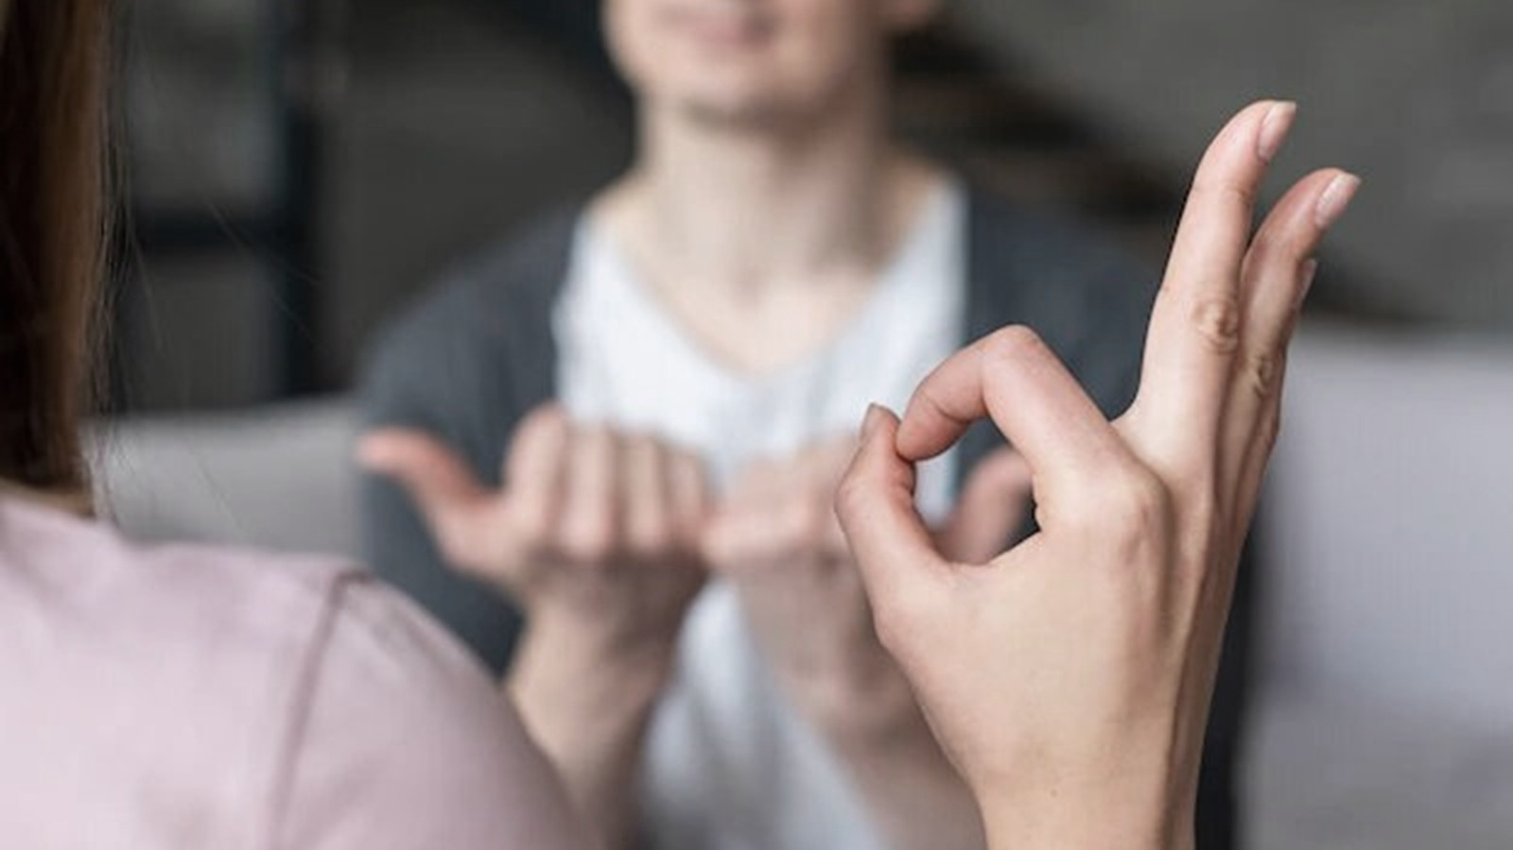
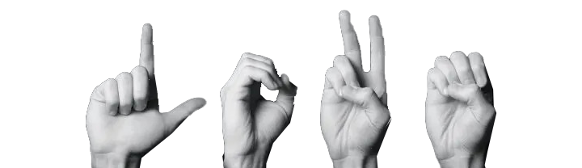
Enhanced Sign Language Recognition using Deep Learning And Computer Vision
Graduation project 2

Slide 2
Project description
An intake on the of they project contents
Identifying the problem
Identifying the target purpose of the project.
Index:
Project Methodology
Deciding the approach for building the system.
A list of the topics included in the presentation.
Deep learning model
Describing the model layers .
Results
Previewing the validation results.
Interface design
Showcasing the GUI.

Slide 3


Project description
Provides a comprehensive project overview, including its phases, processes, goals, and objectives.
Sign language, a unique and vital form of communication, is extensively used by Deaf and hard-of-hearing communities worldwide. Despite its importance, the recognition and understanding of sign language pose significant challenges in research and society. This communication gap, largely due to a lack of understanding among the general population, emphasizes the need for a solution.
The aim of this graduation project is to bridge this communication gap, fostering inclusivity by enhancing the recognition and understanding of sign language.
The construction of the sign recognition system was made possible through the integration of several key components. These include preprocessing techniques that prepare the data for analysis, a Gesture Recognition Module that identifies specific sign language gestures, Computer Vision techniques that aid in gesture detection and recognition, Natural Language Processing (NLP) that interprets spoken language, and a User Interface that presents the results in a user-friendly manner.

Slide 4
Identifying the problem
Real-time processing:
Lighting Conditions of the data set images:
Accuracy of Hand Shapes:
Lack of Diversity:
Computer Vision Challenges:
Need for efficient algorithms and powerful hardware
Limited variety in signers, environments, or signs in the dataset.
Difficulty in recognizing similar hand shapes.
Tasks like background subtraction, segmentation, feature extraction for the test dataset.
Impact of shadows, overexposure, or underexposure on gesture visibility.

Slide 5


General Architecture :
Sign language Dataset
Data preprocessing
Feature Extraction
Hand Gesture Classification
Translation
Output Generation
Stage 1
Stage 2
Stage 3
Stage 4
Stage 5
Preprocessing steps :
Data Augmentation
Feature Extraction
Image Enhancement
Step 1
Step 2
Step 3
Step 4

Slide 6
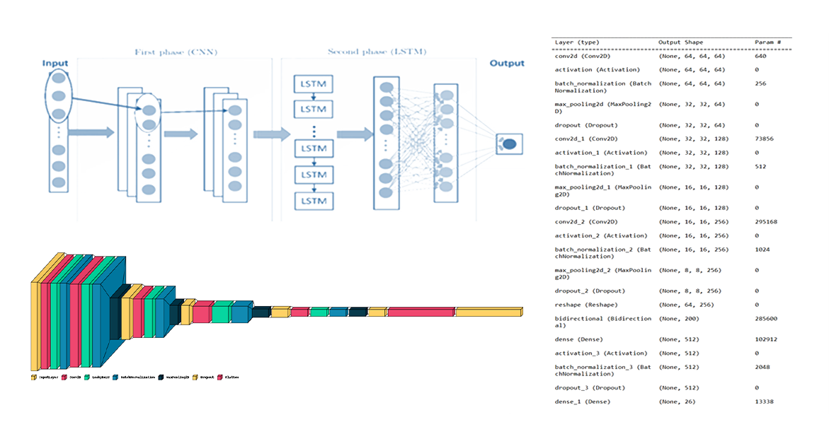
Deep learning model :
Describing the layers of the deep learning model.

Slide 7

General Architecture :
Sign language Dataset
Data preprocessing
Feature Extraction
Hand Gesture Classification
Translation
Output Generation
Stage 1
Stage 2
Stage 3
Stage 4
Stage 5

Slide 8
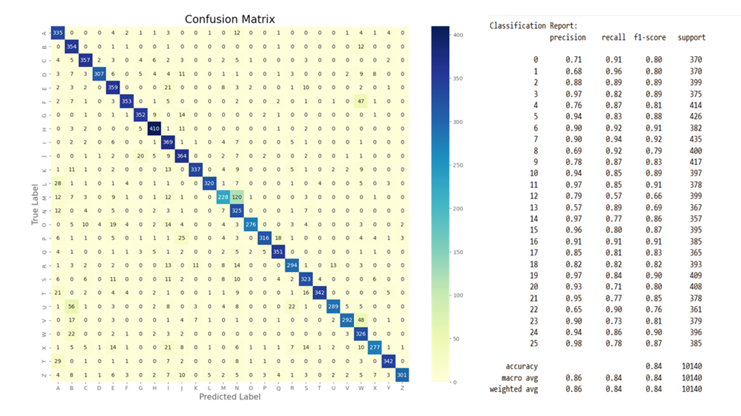
Results
The results of evaluating the model showing the Confusion Matrix, Accuracy, Precision and Recall.

Slide 9

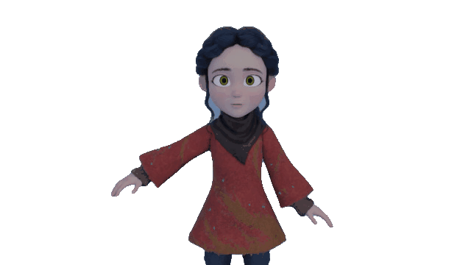
Interface
Previewing the windows for each option in the Graphical user interface.

Slide 10
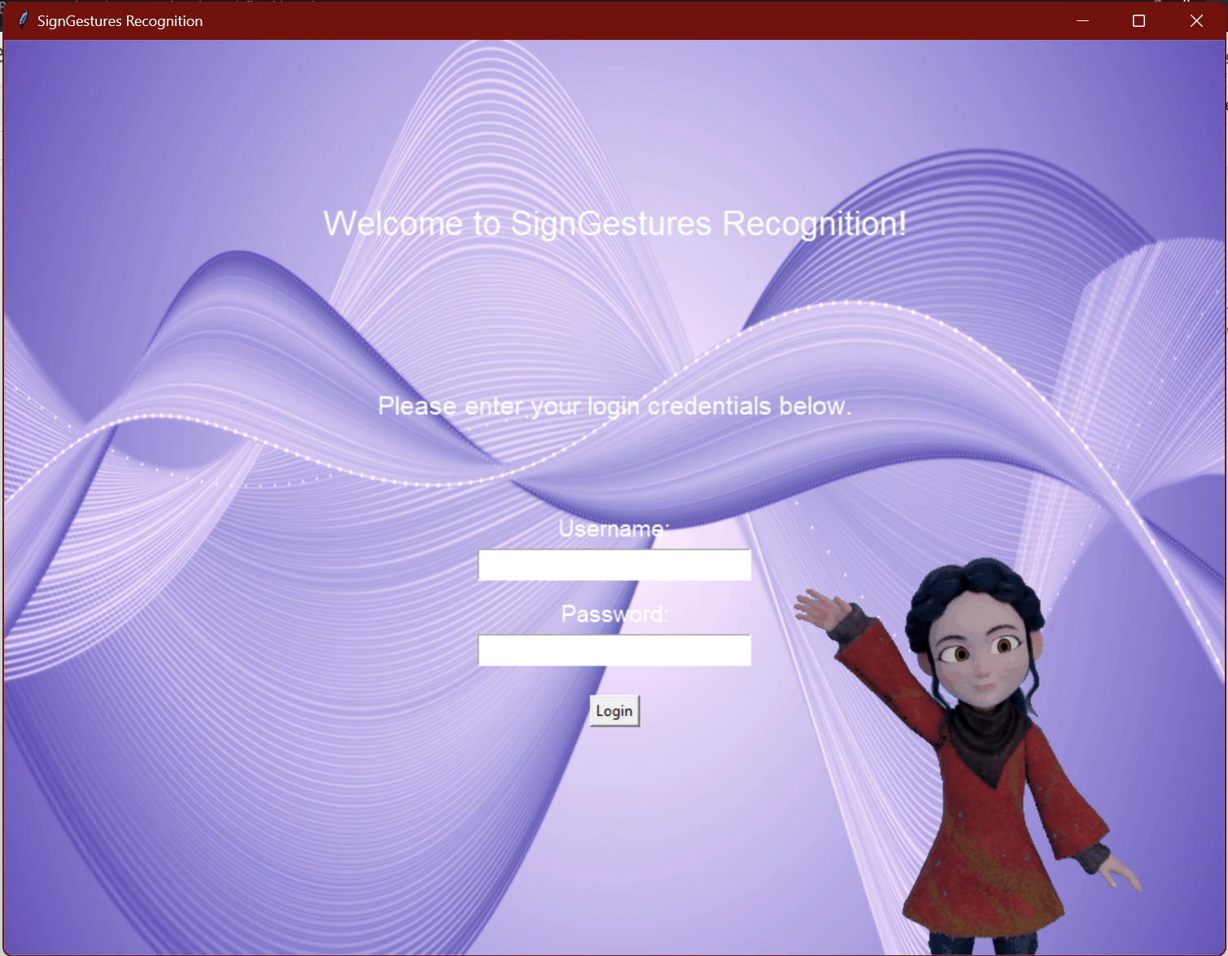
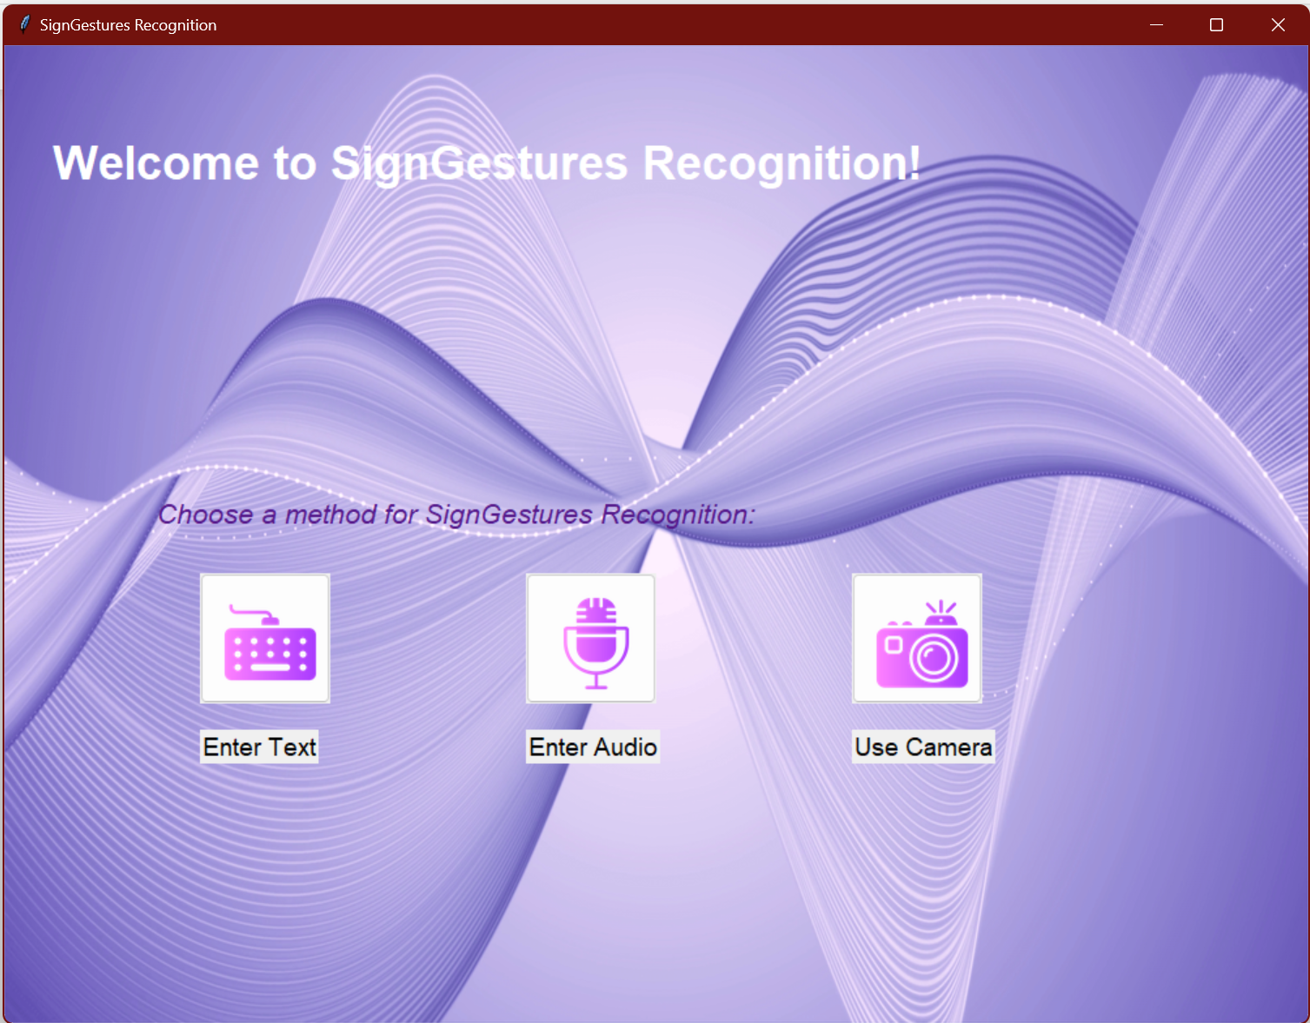
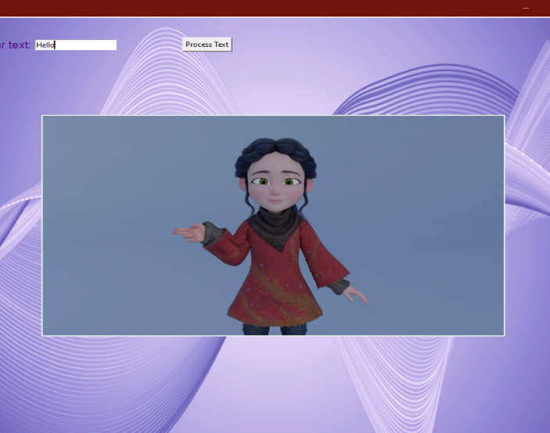
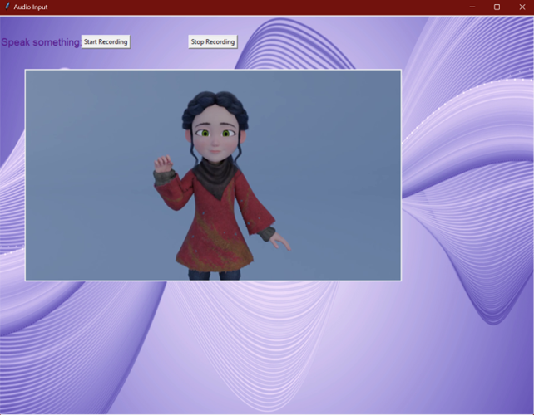
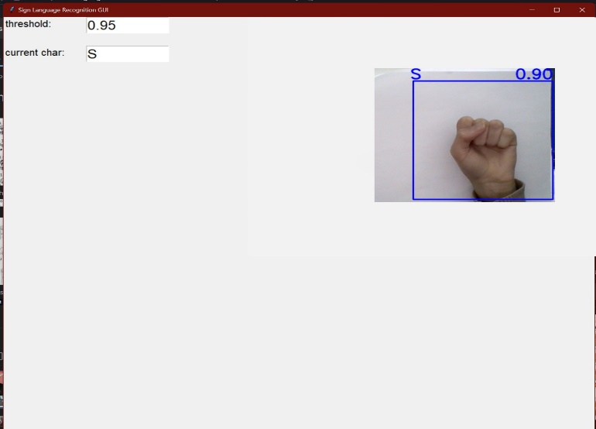
General User Interface
What follows is a series of images displaying the General User Interface.

Slide 11

Thank you

